Slide 1
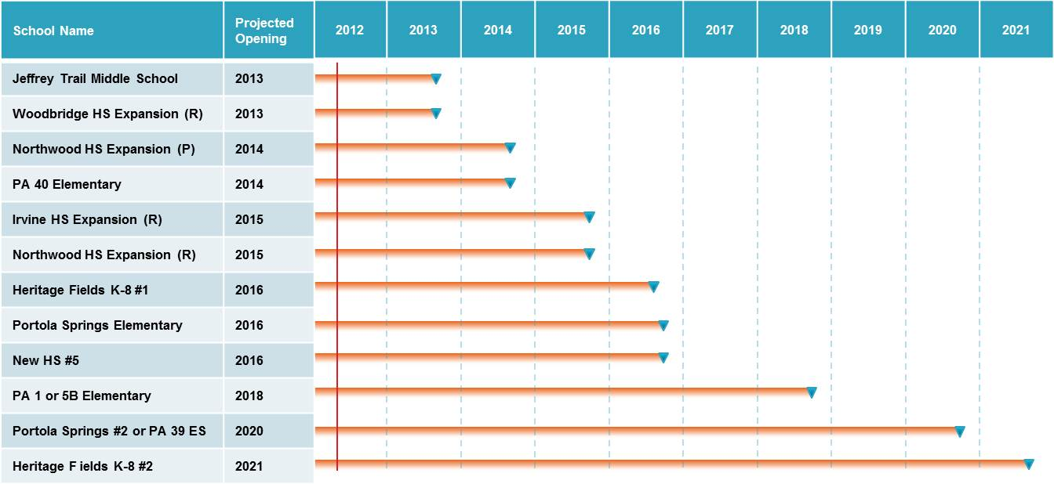
Facilities Advisory Committee
March 29, 2012

Slide 2
A Look Into the Future
Where do we go from here?
Timeline for Future New Schools/Expansions
Schools Eligible for Modernization
Education Specification Enhancements on Existing Schools (sample sites)
Prioritization Process Description

Slide 3
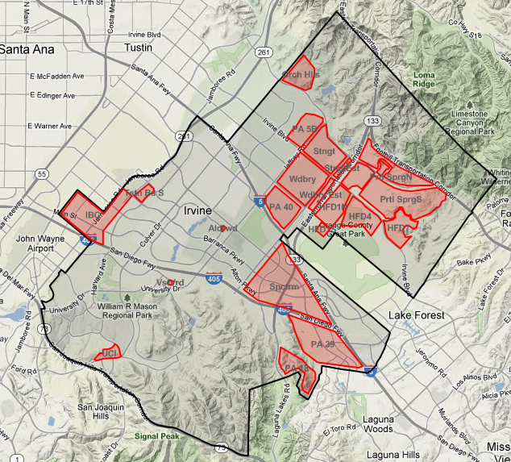
New Residential Development
Stonegate
Orchard Hills
PA 5B
Woodbury
Cypress Village
Columbus Grove
Lambert Ranch
Portola Springs
IBC
Heritage Fields
Alderwood Project
Vista Verde Project
Spectrum
PA 39
UCI
Laguna Altura

Slide 4
K-6 Enrollment Projections Summary (Moderate)
Grade | 2011 | 2012 | 2017 | 2021
K-6 Projection | 15,420 | 16,150 | 20,893 | 23,291
Capacity | 18,483 | 18,483 | 20,933 | 20,933*
Open Seats | 3,063 | 2,333 | 40 | -2,739
School Name | Projected Opening
PA 40 Elementary | 2014
Heritage Fields K-8 #1 | 2016
Portola Springs Elementary | 2016
PA 1 or 5B Elementary* | 2018
Portola Springs #2 or PA 39 Elementary* | 2020
Heritage Fields K-8 #2* | 2021
2012 | 2013 | 2014 | 2015 | 2016 | 2017 | 2018 | 2019 | 2020 | 2021
* Capacity not included in Total
Notes:
Lorrie - Have k enrollment handout to answer questions
Capacity PA 40, Heritage Fields #1, Portola Springs
Footnote…schools not in projection

Slide 5
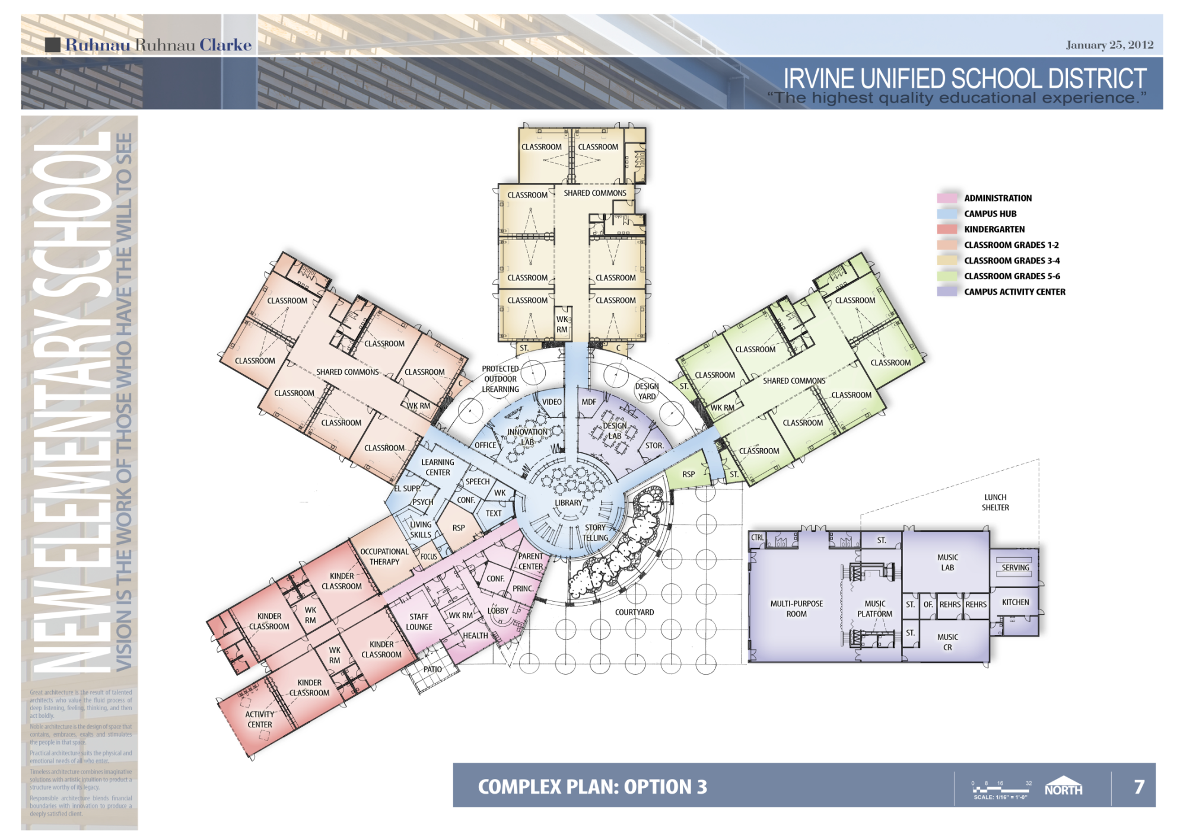
PA 40 Elementary School

Slide 6
7-8 Enrollment Projections Summary (Moderate)
Grade | 2011 | 2012 | 2017 | 2021
7-8 Projection | 3,861 | 4,125 | 5,144 | 5,687
Capacity | 4,435 | 4,435 | 5,285 | 5,285*
Open Seats | 574 | 310 | 141 | -402
School Name | Projected Opening
Jeffrey Trail Middle School | 2013
Heritage Fields K-8 #1 | 2016
Heritage Fields K-8 #2* | 2021
2012 | 2013 | 2014 | 2015 | 2016 | 2017 | 2018 | 2019 | 2020 | 2021
* Capacity not included in Total
Notes:
Capacity does not include K-8’s beyond 1st K-8
Where is capacity an issue in the future

Slide 7
9-12 Enrollment Projections Summary (Moderate)
Grade | 2011 | 2012 | 2016 | 2021
9-12 Projection | 8,722 | 8,890 | 10,840 | 13,730
Capacity | 9,618 | 9,618 | 12,325* | 13,325**
Open Seats | 896 | 728 | 1,485 | -405
School Name | Projected Opening
Woodbridge HS Relocatable Expansion | 2013
Northwood HS Classroom Expansion | 2014
Irvine HS Classroom & Relocatable Expansion | 2015
Northwood HS Relocatable Expansion | 2015
New High School #5 | 2016
2012 | 2013 | 2014 | 2015 | 2016 | 2017 | 2018 | 2019 | 2020 | 2021
* Capacity includes Expansions for Permanent Capacity
** Capacity includes Expansions for Permanent Capacity and Relocatable Expansions for Peak Enrollment
Notes:
*Add capacity of expansion and high school projects, peak of 2600 at each existing high school as well as capacity of new high school

Slide 8
Irvine HS Site Plan

Slide 9
Northwood HS Site Plan

Slide 10
State Modernization Eligibility
Site Year Eligible
Irvine HS Bldgs. AB/AC 2012
Woodbridge HS Bldgs. M,C,E, J 2012
Meadow Park Elementary 2012
Brywood Elementary 2013
Springbrook Elementary 2014
Westpark Elementary 2014
Woodbridge HS Bldg. K 2014
University HS Gym/Theater/Science 2017
South Lake Middle 2019

Slide 11
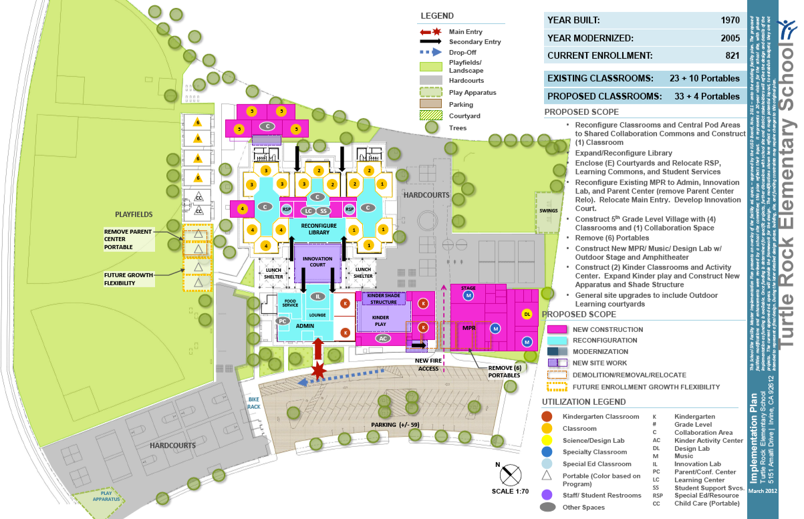
Turtle Rock ES Ed Spec Enhancements

Slide 12
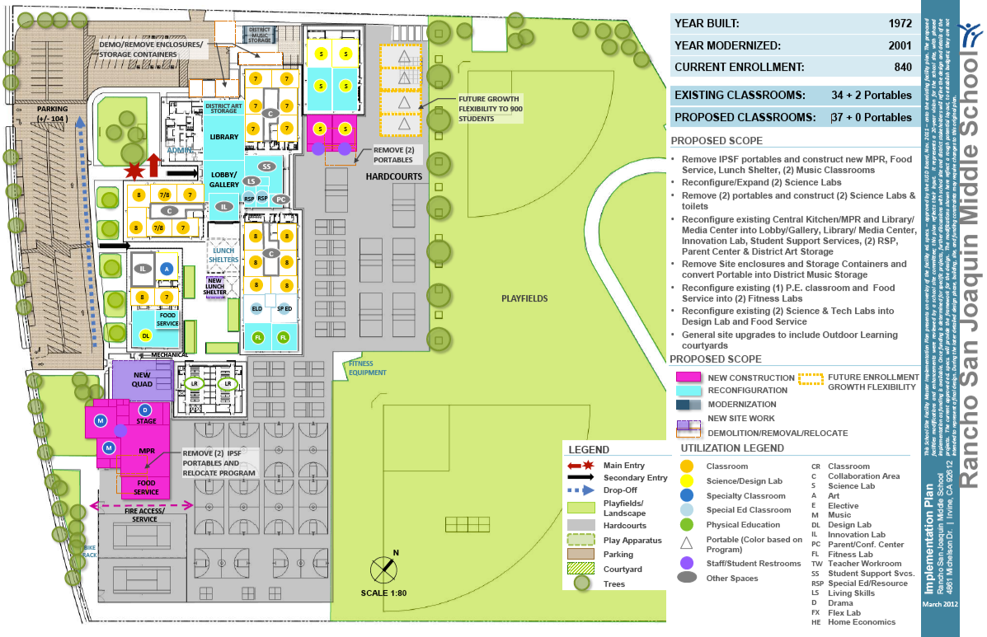
RSJMS Ed Spec Enhancements

Slide 13
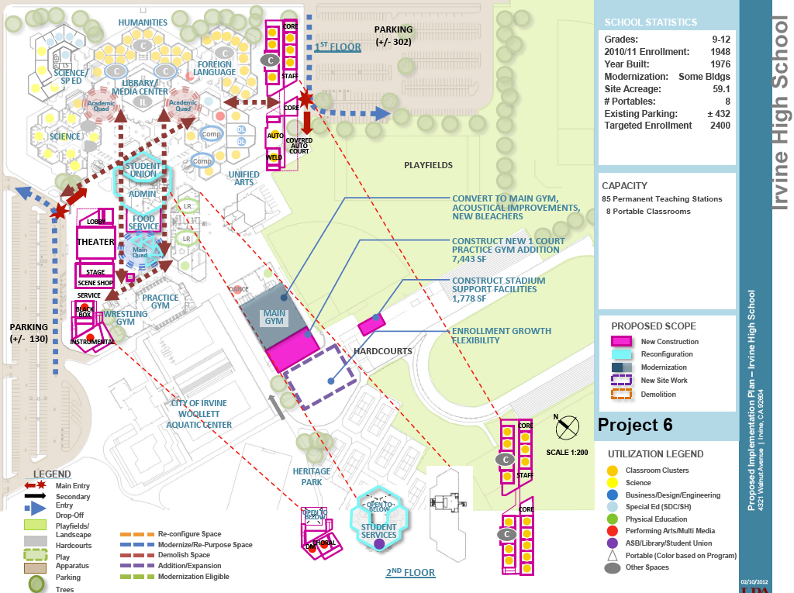
Irvine HS Ed Spec Enhancements

Slide 14
Prioritization Definition - Master Planning as a Living Process
As dollars become available to implement the Comprehensive Long Range Facilities Master Plan recommendations, the Irvine Unified School District will evaluate future projects and future project scope budgets, on a case by case basis. This prioritization evaluation may be based upon consideration of the following criteria:
• Total Funding Available
• Opportunity to Aquire State Funding
• Developer Mitigation Agreements
• Equalization of Educational Opportunities
• District Educational & Support Programs Priorities
• Facilities & Utilities Infrastructure Systems Condition & Age
Projects will be brought forward to the Irvine Unified School District Board of Education for review, discussion and approval prior to proceeding.

Slide 15
Questions ?

Slide 16
Thank you for your participation!

