Slide 1


Regional Center Services: Preparing for your IPP
December 15, 2025
State Council on Developmental Disabilities
Email: Scarlett.vonthenen@scdd.ca.gov
Regional Center of Orange County
Email: ktruong@rcocdd.com

Slide 2
Agenda
01
Lanterman Developmental Disabilities Services Act
02
Regional Center Services & Supports
03
Living Options
04
Person Centered Planning/Individual Program Plan

Slide 3
“The schools are not required to provide the same level of services as the regional centers are required to provide under the Lanterman Act. The school districts must provide only a free and appropriate public education (FAPE) which provides personalized instruction with sufficient support services to permit the student to benefit educationally from that instruction. (Hendrick Hudson Dist. Bd. of Ed. v. Rowley (1982) 458 U.S. 176.) This does not mean the best possible education, only one providing some benefit. The Lanterman Act sets out a different and higher standard: providing services that foster developmental potential; services which are directed toward achievement “of the most independent, productive, and normal lives possible.” (Section 4502, subdivision (a).) The regional centers must provide services and supports that allow the consumer to integrate “into the mainstream life of the community” and to “approximate the pattern of everyday living available to people without disabilities of the same age.” (Section 4501. See also, section 4648, subdivision (a) (1).) The requirement that the regional centers maximize opportunities and assist in achieving “the most” normal lives sets a far higher standard than the provision of “some benefit” which is what is required of the schools. Of course, the obligations created by the Lanterman Act are tempered by the obligation to provide the services in a cost-effective manner, but plainly the regional centers’ purposes and obligations are much higher than those of the schools. “
  Excerpt from OAH Case No. L 2005070685
  Kevin G. v. Frank D. Lanterman Regional Center (January 2006)
  Administrative Law Judge: Christine C. McCall

Slide 4
Under the Lanterman Act, the Legislature has decreed that persons with developmental disabilities have a right to treatment and rehabilitative services and supports in the least restrictive environment and provided in the natural community settings as well as the right to choose their own program planning and implementation. (Section 4502.) The Legislature has further declared that regional centers are to provide or secure family supports that, in part, respect and support the decision making authority of the family, are flexible and creative in meeting the unique and individual needs of the families as they evolve over time, and build on family strengths and natural supports. (Section 4685, subd. (b).) Services by regional centers must be provided in the most cost-effective and beneficial manner (sections 9 4685, subd. (c)(3), and 4848, subd. (a)(11)) and must be individually tailored to the consumer (section 4648, subd. (a)(2)). Further, section 4648, subdivision (a)(8), provides that regional center funds shall not be used to supplant the budget of any agency which has a legal responsibility to serve all members of the general public and is receiving funds to provide those services. Section 4659, subdivision (a)(1), directs regional centers to identify and pursue all possible sources of funding for consumers receiving regional center services.
  Excerpt from OAH Case No. 2011120545
  Tingya T. Y. v. Regional Center of Orange County (February 2012)
  Administrative Law Judge David B. Rosenman

Slide 5
Starting Point
The IPP/PCP is the starting point!
IPP process helps people with developmental disabilities, and their families, obtain the services and supports needed to build capabilities*
  Collaborative process
  Describes the needs, preferences, and choices of the person served and/or family
  Includes measurable desirable outcomes and the plan to achieve those goal
Can be held anytime a need arises (regional center must hold the meeting within 30 days after the request is made)
  *WIC §4646.5(a)
Notes:
The Individual Program Plan (IPP) is also known as a Person Centered Plan (PCP) and is for regional center consumer’s age 3 and older. For those in early start (infant to the day before the third birthday), the meeting is typically referred to as an Individual Family Service Plan or IFSP.
The intent of the IPP is to help people with DD and their families obtain the services and supports needed to build capabilities. The IPP meeting and the subsequent document generated from the meeting is a collaborative process involving parents, the person with the DD, the regional center, service providers, and members of the consumer's circle of support. In the next few slides, we will talk about the members of the IPP Team. The IPP is supposed to describe the needs, preferences, and choices of the consumer and/or family. It is also supposed to include measurable desirable outcomes and the plan on how to achieve those goals.

Slide 6
Starting Point
The IPP Team develops the content for the IPP
Service Coordinator documents the IPP meeting
You review it and make additions/corrections
Do not sign that you agree with the IPP document until you have a copy of it!
The Service Coordinator is responsible for “implementing, overseeing, and monitoring each individual program plan” WIC §4647(b)
Notes:
This IPP Team discusses and develops the content for the IPP document. The regional center service coordinator will take notes during the meeting and document in an IPP what took place.
Your input is important! You have a right to review the document and make changes, additions, and corrections in order to make certain that it is accurate reflection of the regional center consumer. It is so important that when you receive the document, typically within 45 days following the meeting, that you take the time to read it and make sure what you said is incorporated in the report. This is a legal document! You may have said it at the meeting, but if it is not captured in the report, then it leaves it open to people’s memory and recollection of a meeting that took place 3 months ago or 1 year ago. Make sure that what is important to you is captured in the document!
As this is a legal document that is utilized during disagreements and through the appeal process, do not sign that you are in agreement with the IPP document until you have a copy of it! You are welcome to sign in attendance, but you really should not sign in agreement until you have reviewed the actual IPP document itself.
The law states that the SC is responsible for “implementing, overseeing, and monitoring each individual program plan,” so hence the reason why it is so important to document what you want the SC to oversee and monitor. (a) Pursuant to Section 4640.7, service coordination shall include those activities necessary to implement an individual program plan, including, but not limited to, participation in the individual program plan process; assurance that the planning team considers all appropriate options for meeting each individual program plan objective; securing, through purchasing or by obtaining from generic agencies or other resources, services and supports specified in the person's individual program plan; coordination of service and support programs; collection and dissemination of information; and monitoring implementation of the plan to ascertain that objectives have been fulfilled and to assist in revising the plan as necessary.

Slide 7
Services & Supports
“An array of services and supports should be established which is sufficiently complete to meet the needs and choices of each person with developmental disabilities, regardless of age or degree of disability, and at each stage of life and to support their integration into the mainstream life of the community. To the maximum extent feasible, services and supports should be available throughout the state to prevent the dislocation of persons with developmental disabilities from their home communities. “ (WIC §4501, emphasis added)
“The Legislature finds that the mere existence or the delivery of services and supports is, in itself, insufficient evidence of program effectiveness. It is the intent of the Legislature that agencies serving persons with developmental disabilities shall produce evidence that their services have resulted in consumer or family empowerment and in more independent, productive, and normal lives for the persons served.” (WIC §4501, emphasis added)

Slide 8
Determining Services & Supports
  Ask yourself these questions. The answers will help you identify your goals.
  Where does the person want to live?
  What services does the individual need to help them live where they want?
  In what ways would you like the person served to be included in the community? What does the person served want to do for fun, in their free time? And do they need help to do those things?
  In what ways would you like the person served to be included in school and/or work?
  What does the person served need to become more integrated in the community and at work? For example, the person served may need to learn certain self-help strategies, or get help with a medical or behavioral concern.
  Does the person served have cultural and lifestyle preferences that should be taken into consideration as far as services and supports?
“IPP/IFSP Meeting Planner for Families with Children” Supplement L - Rights Under The Lanterman Act Manual
Disability Rights California – www.disabilityrightsca.org
Notes:
To help you plan for your IPP meeting, ask yourself these questions. The answers will help you identify your goals.
Where does the person want to live? Right now, in 5 years, in 15 years and
Number 2, what services does the individual need to help them live where they want. – our preferences change as we age and the goal is regardless of where the person served lives, they receive skills training and community integration so that in any environment they are maximizing their potential and are increasing their independence at home and within their community.
#3

Slide 9
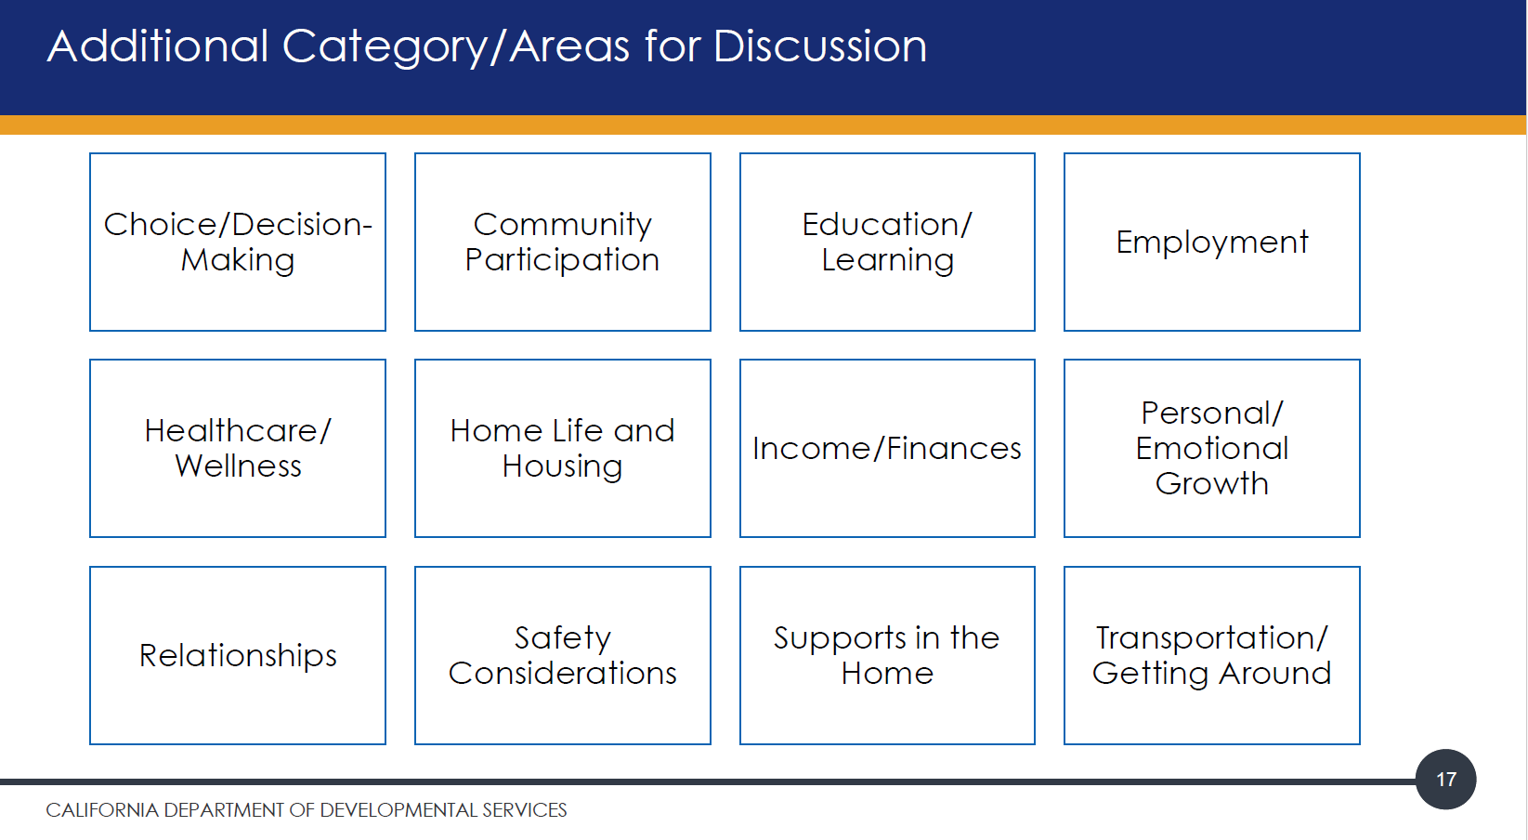

Slide 10
The team together thinks about and creates a plan for the person to achieve a more meaningful life
Professionals and the entire group link people to resources
Focus on person-centered – what is important to and important for the person served
  A guided process for learning how you want to live and developing a plan to make it happen
  Discover what is important to you in everyday life
  Identify what support you require and any issues of health or safety
https://www.youtube.com/watch?v=y77y7XW8GtE Beth Mount Video
Notes:
The focus should be on the person served and the meeting should be person centered and person driven.
https://www.youtube.com/watch?v=y77y7XW8GtE

Slide 11
Regional centers must provide or secure services and supports that:
  Respect and support the decision making authority of the family
  Flexible and creative in meeting unique needs
  Build on family strengths, natural supports, community resources
  Are culturally competent
  Promote inclusion
  WIC §4685(b)
Notes:
READ OUT LOUD
Alongside the above Welfare and Institutions Code regarding services/supports, I want to share a couple others that really stand out in the law and really help us understand what the Lanterman Act and, in turn, the regional centers must provide to support families and persons with developmental disabilities.
As mentioned earlier WIC 4501 states that
“An array of services and supports should be established which is sufficiently complete to meet the needs and choices of each person with developmental disabilities, regardless of age or degree of disability, and at each stage of life and to support their integration into the mainstream life of the community.”

Slide 12
POS Guidelines
In seeking services and supports from the regional center, the POS Guidelines…
    Provide some of the services available through regional center
    Provide criteria used to determine eligibility for each service
    Clarify level of service and length of service timeframes
    Identify regional center’s guiding principles
    May help resolve disagreements in requested services (such as an exception to POS Guidelines)
Notes:
Each regional center develops its own Purchase of Service Guidelines based on its guiding principles, and in accordance with the Lanterman Developmental Disabilities Services Act and Early Intervention Services Act. The Department of Developmental Services reviews and approves the POS Guidelines and it is then adopted by the regional center’s Board of Directors. The regional center staff use the POS Guidelines when authorizing service requests from consumers and families.
The list is not comprehensive and does not include all the services and supports the regional center offers. It is merely a guideline of commonly utilized services. Just because the service is not listed does not mean that it does not exist – talk to your service coordinator about your child, or adult child’s, needs, and the needs of your family if the consumer resides in the family home. All regional center services should be individually tailored to meet the individual’s unique needs. There is no “one size fits all” regarding services, the type of service, amount of service, and frequency of the service all vary depending on the needs.
Basically, if you are seeking services and supports from your local regional center, the POS Guidelines will …
show you some services available through the regional center
show you the criteria used to determine family/consumer eligibility for each service
help you understand your eligibility for a service
help you understand level of service and how long the service contract lasts
identify regional center’s guiding principles
help everyone in working together through disagreements and exception situations
serve as a reference document for you to keep and use
Please note that the POS Guidelines is periodically revised to remain current with legal changes and community needs

Slide 13
POS Guidelines
The list does not include all possible services!
The circle of support should work very closely with the regional center to develop the most appropriate service plan for the consumer and family with a minor child living at home.
Make your needs known!
There are customized and creative methods to help support the consumer (and family) in difficult situations
There are always exceptions to the POS Guidelines!
RCOC Service Listing: https://padlet.com/CCFRC/rcoc_service_lists
Notes:
Again, the list is not comprehensive. Each family/person with a DD should work very closely with your regional center to develop the most appropriate service plan for the consumer and family with a minor child living at home.
You need to make your needs known. We strongly encourage open lines of communication as there are customized and creative methods to help support the consumer and family in difficult situations.
If you don’t communicate your need or concern with your regional center service coordinator, how are they supposed to know that you are in need of additional support.
I can’t emphasize enough that there are always exceptions to the POS Guidelines, made on a case-by-case basis.

Slide 14
Generic Resources
RCOC is the payor of last resort (WIC §4659)
  Utilize generic resources first; get denial letters –
    California Children’s Services (CCS)
    Medi-Cal or Private insurance
    School district
    In-Home Supportive Services (IHSS)
    Department of Rehabilitation (DOR)
“Regional center funds shall not be used to supplant the budget of any agency that has a legal responsibility to serve all members of the general public and is receiving public funds for providing those services.” WIC 4648(a)(8)
If other agencies deny the request, go back to RCOC with the denial letters and make your request again.
Notes:
That being said, the law does dictate that families and persons with developmental disabilities access generic resources first, as the regional center is considered the payor of last resort. The easiest example of this is for an adult who needs health insurance, Medi-Cal would be the generic resource. For a child who has orthopedic needs and requires some durable medical equipment, such a wheelchair, walker, or gait trainer, California Children’s Services would be the generic resource.
So essentially, families and consumers need to first try to access the necessary service from the generic resource. If, however, the generic resource denies your request, then go back to your regional center with the denial letter and present your request again. They are the payor of last resort so at such point that you exhaust the other public service agencies, you should re-present your needs, requests, and denial letters to the regional center for their funding.

Slide 15
Things to Remember
The information provided at the IPP dictates what services and supports the individual is eligible to receive (WIC §4512(b))
  The regional center will fund for which agency/service to help accomplish goal
  Ensure the plans are consistent in accomplishing goal
The Regional Center funded service must be necessary to accomplish an identified goal. (WIC 4512(b))
And, continued funding for that service is dependent upon reasonable progress being made toward the objectives (WIC §4648(a)(6-7)
You can tape record the IPP meeting - provide 24 hours written notice (WIC §4646.6)

Slide 16
Things to Remember
Every service and support should be listed on the IPP, including those obtained by generic resources.
If there is any service or support you need/want, even those from other agencies, ask your service coordinator to include it in the IPP, as a service/support you are trying to secure.
If written in the IPP, the regional center must…
  Provide it themselves, or
  Advocate for you to get it (or continue receiving it) from another agency.
  *WIC §4648

Slide 17
Things to Remember
“What types of services does the Regional Center offer?”
  Each RC must post on their website a list of their vendored service providers, generally broken down by category/type of service
  RCOC: https://www.rcocdd.com/vendor-resources/current-service-providers/
  Helpful to know who Regional Center vendors and for what service.
  However, just because a service type is not listed in their vendor directory and/or POS Guidelines, does not mean the RC can’t fund for it.
For all services,
  You must establish the need for that service
  The need must be related to your disability
  You have exhausted generic resources
Notes:
Point 3
(e) If necessary to expand the availability of needed services of good quality, a regional center may take actions that include, but are not limited to, the following:
(1) Soliciting an individual or agency by requests for proposals or other means, to provide needed services or supports not presently available.
(2) Requesting funds from the Program Development Fund, pursuant to Section 4677 , or community placement plan funds designated from that fund, to reimburse the startup costs needed to initiate a new program of services and supports.
(3) Using creative and innovative service delivery models, including, but not limited to, natural supports.

Slide 18
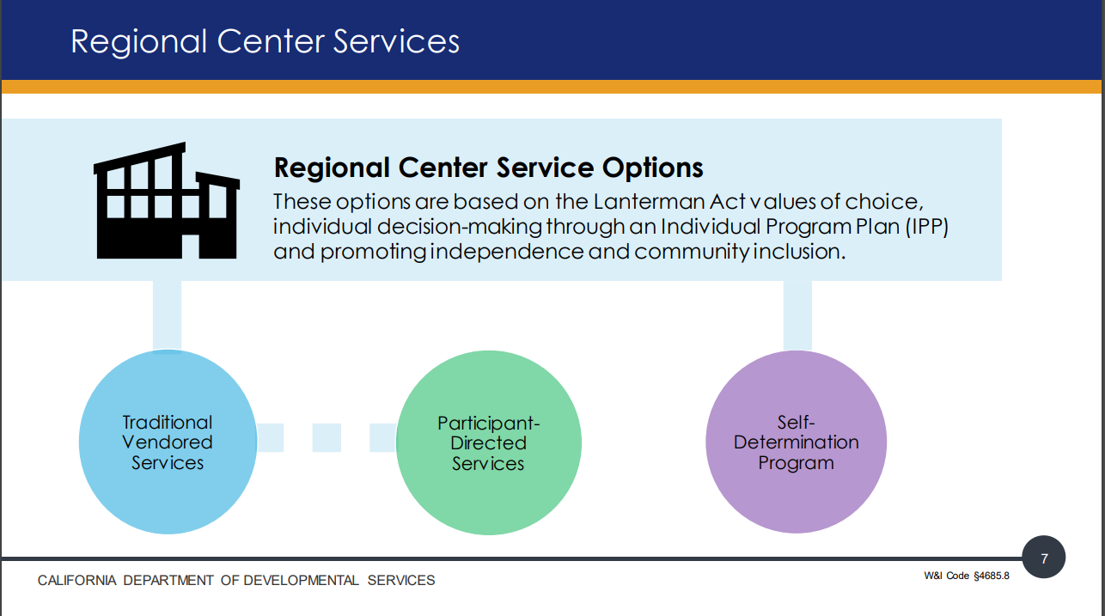
New(er) Regional Center delivery methods
Traditional Model - all of your services are through vendored providers. Vendored providers have a contract with your regional center to provide services.
Participant Directed Services - mix of self-directed and traditional services. Participant-Directed Services allows you to use vendored services and some non-vendored services to meet your needs in the IPP.
Self-Determination Program (SDP) - the participant has both budget authority through their individual budget and spending plan and employer authority through being able to hire both vendored and non-vendored service providers.
Notes:
Traditional Vendored Services
How most individuals receive services today
RC works with the family, individual and IPP team to identify services
RC helps the family and individual identify vendored service providers
Participant-Directed Services (PDS) – allows consumers employer authority
Gives individuals and families more control over how and by who IPP services are provided
You choose who to hire, schedule when the person works and supervise the work
Must use a Financial Management Service (FMS) agency to help hire, pay
and verify skills of staff
Currently, consumers can coordinate respite, day care, transportation, nursing, and day services through participant-directed services.
The Self-Determination Program (SDP) – allows participants both employer and budget authority (W&I Code 4685.8)
Offers flexibility and choice along with increased responsibility
IPP and SDP team develop a budget used to purchase services and supports needed
Can purchase some services that others cannot access
Must use an FMS to help manage budgets, hire and pay staff and comply with employment laws

Slide 19
Standardized IPP Template
January 2025

Slide 20
All regional centers will implement and use this new template starting January 1, 2025.
View new standardized template, guidance, and resources here:
Standardized Individual Program Plan Template and Procedures
Enclosure A – Individual Program Plan Template
Enclosure B – Individual Program Plan Agreement and Signature Form
Enclosure C – Individual Program Plan Guide for Regional Centers
Source site: https://www.dds.ca.gov/rc/ipp/

Slide 21
Services Available
The services and supports that regional centers provide include, but are not limited to, those listed below. This list is from section 4512(b) of the Lanterman Act, but if a consumer needs a service not contained in this list, the IPP team may still authorize it.
- Adaptive equipment services
- Advocacy
- Advocacy assistance or facilitation
- Assessment
- Assistance in finding, modifying and maintaining a home
- Behavior Modification
- Camping
Childcare
- Community integration services
- Community residential placement
- Community support facilitation
- Counseling for the consumer
- Counseling for the consumer’s family
- Daily living skills training
Day care
- Development and provision of a 24 hour emergency response system
- Development of unpaid natural supports
- Diagnosis
- Diapers
- Domiciliary care
- Education
- Emergency and crisis intervention
- Emergency Housing
Notes:
Disability Rights California published a fantastic publication entitled “Rights Under the Lanterman Act” (commonly referred to as the RULA). It is a comprehensive, easy to read, publication that explains a persons rights under the Lanterman Act - it explains regional center services and how to get those services, as well as the process for handling disagreements. This and the next 2 slides are a direct cut/paste from this publication that lists some of the services and supports that the regional centers provide. As an independent facilitator that maybe assisting your client, or even a parent assisting your child, this list is noncomprehensive, but it helps you identify services that can be obtained from the regional center. It may also give you for ideas to look into that may help round support or provide a more wholistic approach.
To ensure accessibility for all users, I will read through the services/supports on this slide and the next two.

Slide 22
Services Available
- Emergency relief for personal care attendants
- Evaluation
- Facilitated circles of support
- Facilitation, including outreach and education
- Facilitation with a facilitator of the consumer’s choosing.
- Financial assistance
- Follow-along services
- Foster family placement
- Habilitation
- Home location assistance
- Homemaker services
Identification of circles of support
- Infant stimulation programs
- Information and referral services
- Mental health services
- Occupational therapy
- Paid neighbors
- Paid roommates
- Parent training
- Peer advocates
- Personal care or assistance
- Physical therapy
- Protection of civil, service and legal rights
- Protective services
- Provision of circles of support
Recreation
- Recruiting, hiring and training personal care attendants
- Respite
- Respite for personal care attendants
- Self-advocacy training
- Sexuality training
- Sheltered employment
- Short term out-of-home care
- Social services
- Social skills training
- Sociolegal services

Slide 23
Services Available
- Special living arrangements
- Specialized dental care
- Specialized medical care
- Speech therapy
- Support services for consumers in homes they own or lease
- Supported employment
- Supported living arrangements
- Technical assistance
- Training
- Transportation services
- Travel training
- Treatment
- Vouchered services
Services and supports that are necessary for families to maintain their children with developmental disabilities at home, when living at home is in the best interest of the child.
- Services and supports needed to maintain and strengthen the family unit, where one or both parents is an individual with developmental disabilities.
- Other service and support options which would result in greater self-sufficiency for the consumer and cost- effectiveness to the state.
Courtesy of Disability Rights California “Rights Under the Lanterman Act” Supplement C
www.disabilityrightsca.org

Slide 24
Resources
Disability Rights California “Rights Under the Lanterman Act” https://rula.disabilityrightsca.org/
Disability Rights California – additional regional center fact sheets/resources https://www.disabilityrightsca.org/resources/regional-center
Department of Developmental Services (DDS) www.dds.ca.gov
DDS link to Regional Center Services and Descriptions https://www.dds.ca.gov/rc/rc-services/

Slide 25
Thank you

