Slide 1


Slide 2
In-Home Supportive Services (IHSS)
Essentials: Getting the help you need
Scarlett vonThenen

Slide 3
What is IHSS?
Program through the Adult Services branch of the Orange County Social Services Agency
Overseen by California Department of Social Services (SCDD)
Funds care providers so that a person can live safely at home (own home or family home)
    Includes those who would be able to return home from a hospital, nursing facility, or board and care
    IHSS is an alternative to out-of-home care

Slide 4
Continue…
Recipient is responsible for locating and supervising care provider
Care provider checks issued by State of California directly to care provider
    Current Orange County wage = $18.90 per hour as of January 2026
Hours authorized
    Average 112.1 hours per month for persons with disabilities (statewide average = 118.3 hours/month)
    Maximum 283 hours per month

Slide 5
Eligibility
Must have a disability, vision impairment/blind, or elderly (age 65+)
    Percentage of IHSS recipients within OC: 53% disabled, 1.0% blind, 46% elderly
Must be unable to live safely at home without help
Must meet financial need requirement
Must be a Medi-Cal recipient
    Includes children on Medi-Cal through “Institutional Deeming” (HCBS DD Waiver)
Some recipients with higher incomes may have a share of cost (SOC). This is determined by Medi-Cal. (Income too high to qualify for SSI, but low enough to receive Medi-Cal)

Slide 6
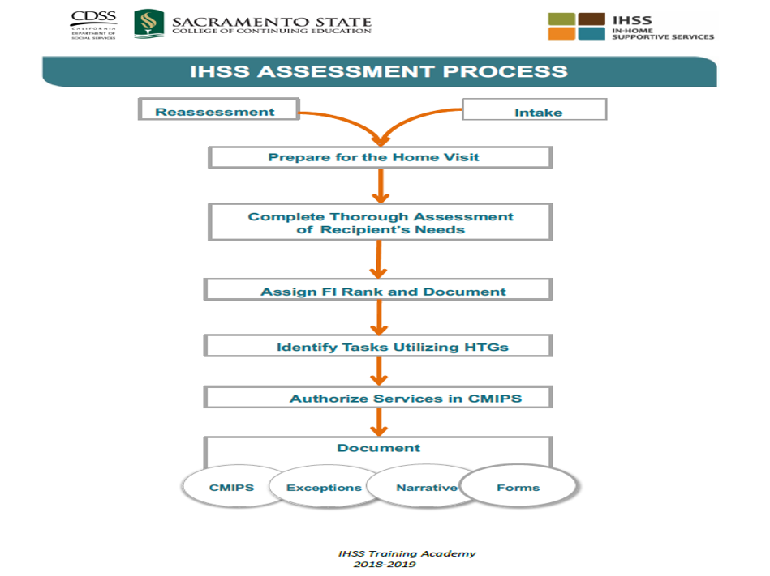
**HTG = hourly task guidelines
**CMIPS = Case Management Information & Payrolling System

Slide 7
Eligibility Timeline
MPP 30-759.2
Agency shall process applications; e.g., complete initial needs assessments, determine eligibility, and send notices of action no later than 30 days following the date of the application.
    An exception may be made when a disability determination has not been received in the 30-day period.

Slide 8
How to Apply
Easiest way – apply by phone and speak with an IHSS Intake Worker 714-825-3000 (Orange County Social Services Agency)
Find your county’s IHSS office here: https://www.cdss.ca.gov/inforesources/county-ihss-offices
SOC 295 - APPLICATION FOR IN-HOME SUPPORTIVE SERVICES
SOC 873 - IN-HOME SUPPORTIVE SERVICES (IHSS) PROGRAM HEALTH CARE CERTIFICATION FORM (DOCTOR COMPLETED)

Slide 9
Determining Recipient’s Needs
Related Services
  Cleaning
  Laundry
  Shopping for food and other errands
  Cooking and meal clean-up
Accompaniment Services
  Medical appointments
Domestic Services
  Clean floors, wash kitchen, take out trash, dust, make bed
  Not applicable to minors
Travel Time & Medical Wait Time
Paramedical Services
  Activities including the administration of medications, puncturing skin, or inserting a medical device, etc.
Personal Care Services
  Respiration assistance
  Bowel, bladder care
  Feeding
  Bed baths
  Dressing
  Menstrual care
  Ambulation
  Move in/out of bed
  Bathe, oral hygiene
  Repositioning, transferring
  Assistance with prosthesis

Slide 10
Functional Index Ranking MPP § 30-756.
Rank 1: Independent: able to perform function without human assistance, although the recipient may have difficulty in performing the function, but the completion of the function, with or without a device or mobility aid, poses no substantial risk to his or her safety.
Rank 2: Able to perform a function, but needs verbal assistance, such as reminding, guidance, or encouragement.
Rank 3: Can perform the function with some human assistance, including, but not limited to, direct physical assistance from a provider.
Rank 4: Can perform a function but only with substantial human assistance.
Rank 5: Cannot perform the function, with or without human assistance.
The rank for each function must be based on physical, cognitive, and emotional impairments in functioning

Slide 11
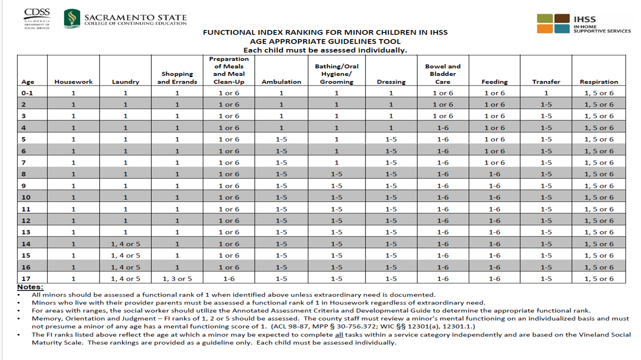
FUNCTIONAL INDEX RANKING TABLE

Slide 12
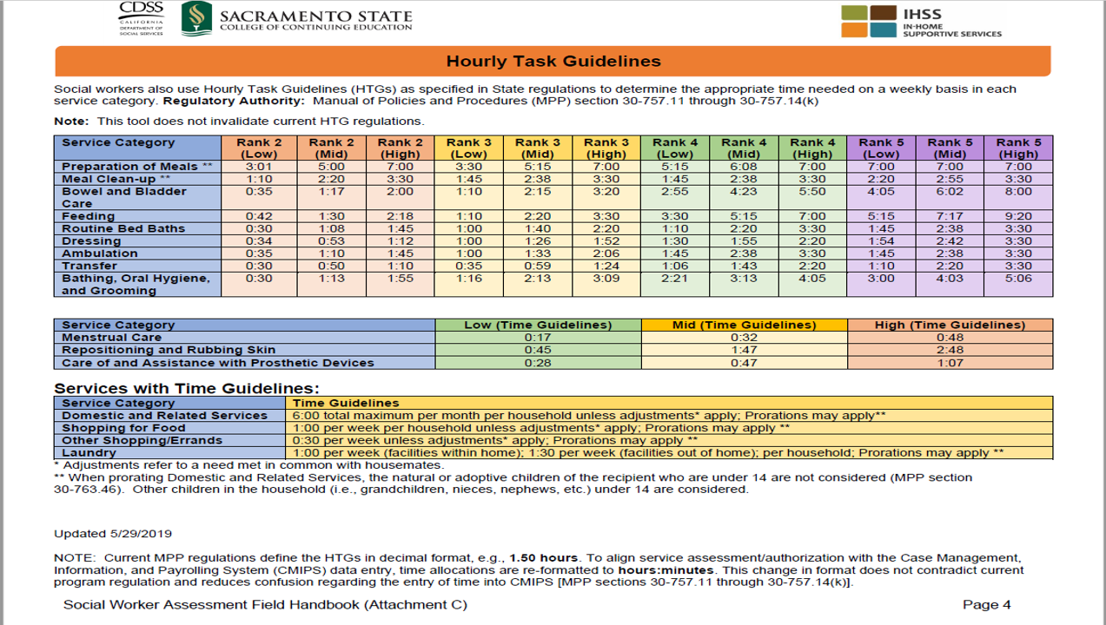
HOURLY TASK GUIDELINES TABLE

Slide 13
Hours Authorized
https://drive.google.com/file/d/1_8bgltxKgOgiX01bJ65xngqpgsoaVqFN/view?usp=sharing
ATTACHMENT B - ANNOTATED ASSESSMENT CRITERIA ALL-COUNTY LETTER 06-34

Slide 14
Protective Supervision

Slide 15
Forms
SOC 821 - ASSESSMENT OF NEED FOR PROTECTIVE SUPERVISION
FOR IN-HOME SUPPORTIVE SERVICES PROGRAM
SOC 825 - PROTECTIVE SUPERVISION 24-HOURS-A-DAY COVERAGE PLAN
F063-23-169 (8/19) – ASSESSSMENT OF NEED FOR PROTECTIVE SUPERVISION ATTACHMENT
SOC 873 - IN-HOME SUPPORTIVE SERVICES (IHSS) PROGRAM HEALTH CARE CERTIFICATION FORM (DOCTOR COMPLETED)

Slide 16
MPP 30-757.17; MPP 30-757.171
Protective Supervision consists of observing recipient behavior and intervening as appropriate in order to safeguard the recipient against injury, hazard, or accident.
Protective Supervision is available for observing the behavior of non-self-directing, confused, mentally impaired, or mentally ill persons that may place themselves in harms way.
At the time of the initial assessment or reassessment, a need exists for 24 hours per day of supervision in order for the recipient to remain at home safely.

Slide 17
Can young children qualify for protective supervision?
  Yes! “A county social worker should always assess an IHSS eligible minor for mental functioning (MPP §30-756.1, 756.2, 761.261).” The following steps must be taken when assessing a minor’s mental functioning:
      SW must review a minor’s mental functioning on an individualized basis and must not presume a minor of any age has a mental functioning score of “1.”
      SW must assess all eligible minors for a mental impairment; documentation must be provided
      SW must evaluate in the functions of memory, orientation, and judgement.
      SW should review the information and documentation provided by the parent. The SW is not required to obtain the information/documentation but should ask parents for it.
  ALL-COUNTY LETTER NO.98-87 (10/30/1998) - settlements of the Garrett v. Anderson and Lam v. Anderson court cases

Slide 18
MPP 30-757.172
Protective Supervision shall not be authorized:
    For friendly visiting or other social activities;
    When the need is caused by a medical condition and the form of the supervision required is medical.
    In anticipation of a medical emergency (e.g., seizures);
    To prevent or control anti-social or aggressive recipient behavior.
    To guard against deliberate self-destructive behavior, such as suicide, or when an individual knowingly intends to harm himself/herself.

Slide 19
SOC 821
The completed form SOC 821 shall not be determinative but considered as one indicator of the need for Protective Supervision.
  Doctor -completed form assessing the individual’s:
    Memory - Recalling learned behaviors and information, short-term and long-term
    Orientation - Awareness of time, place, self, and other individuals in one’s environment.
    Judgment - Making decisions so as not to put self in danger; understands risks and consequences of actions

Slide 20
Demonstrating the Need – From Parent
Parent Journal
Sample hazard log
And if you have LOTS of time on your hands, another sample.

Slide 21
Parent Provider MPP §30-763.451
According to state regulations, a parent can be an IHSS provider if “The parent has left full-time employment or is prevented from obtaining full-time employment because no other suitable provider is available and the inability of the parent to perform supportive services may result in inappropriate placement or inadequate care.” (Manual of Policies and Procedures (MPP) 30-763.451.) Full-time employment means 40 hours per week or more. (MPP 30-763.451(a).)
    You may serve as the IHSS provider for your minor child if you are currently unable to obtain full-time employment because there is no other suitable provider available.
    You may serve if you left full-time employment due to the lack of an available suitable provider
    State law and regulations do not require that you left full time employment at a specific time or for a specific reason
    There is no requirement that you have ever been employed full time
    You may be the IHSS provider even if you have never worked.
    The only requirement is that you are currently prevented from obtaining full time employment due to the level of care your child needs.
https://www.cdss.ca.gov/Portals/9/Additional-Resources/Letters-and-Notices/ACLs/2023/23-106.pdf?ver=2023-12-29-152322-403

Slide 22
Requirements for Language Services
IHSS must provide
  Bilingual staff who speak the language spoken by a substantial number (>5%) of clients served in that respective office
  Interpreter services, upon request, in the language the client has requested for oral communication. This can be done in person or by phone.
MPP §21.115.1,
MPP §21-115.15-.16
ACL 03-56 (10/29/2003)

Slide 23
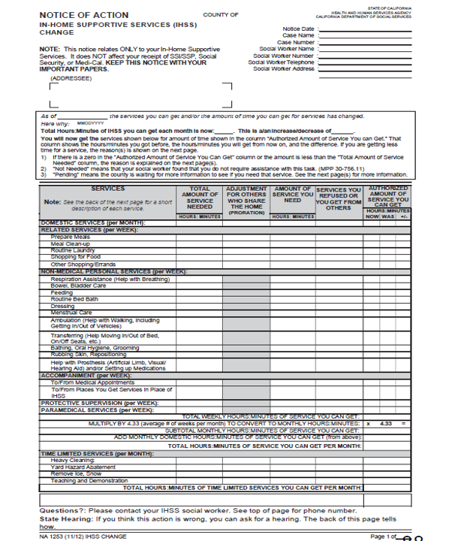
Notice of Action

Slide 24
Appeals

Slide 25
Appeals 1-2
Aid Paid Pending – Your current IHSS hours will remain the same through the pendency of the hearing provided that you file for an appeal 10 calendar days before the Notice of Action is effective
Fair Hearing – You must file for a fair hearing within 90 calendar days if you want to appeal the County’s decision.
You are not eligible for aid paid pending if you file for a hearing after the 10-day timeline.

Slide 26
Appeals 2-2
You have a right to review your IHSS file - Upon request, the County Welfare Department (CWD) shall allow the claimant to examine the case record during regular working hours (MPP 20-051.1)
Be prepared!
  The hearing will include the presentation of evidence (testimony by witnesses, letters, diary log, medical reports) about your needs in the various service categories (daily living activities).
  Your evidence should explain what you need, how long it takes to provide the service, and the reason you need more time

Slide 27
Resources
Disability Rights California
  IHSS-specific publications: http://www.disabilityrightsca.org/issues/inhome_pubs.html.
  Toll-free: 800-776-5746
  www.disabilityrightsca.org
  Office of Clients’ Rights Advocacy (serving RCOC consumers) 714-621-0563
IHSS Public Authority (Orange County)
  Phone: (714) 825-3174
  Email: PublicAuthority@ssa.ocgov.com
  http://www.oc.ca.gov/publicauth/index.asp
UDW Homecare Providers Union Orange County Office
  Toll Free (877) 483-9937
  Office (714) 663-1082
  http://www.udwa.org/counties/orange-county/
State Council on Developmental Disabilities, Orange County Office
2000 East Fourth Street, Suite 115
Santa Ana, CA 92705
(714) 558-4404 www.scdd.ca.gov
California Department of Social Services, Quality Assurance Bureau Provide leadership and oversight to county QA activities in the administration of the IHSS programs.
  Email: IHSS-QA@dss.ca.gov

Slide 28
THANK YOU!

Slide 29

Join Us!

