Slide 1
IRVINE UNIFIED School district
LCAP/Budget Update for Public Hearing
June 11, 2019

Slide 2
IRVINE UNIFIED School district
Local Control
Accountability Plan
Part 1: Plan Summary
2

Slide 3
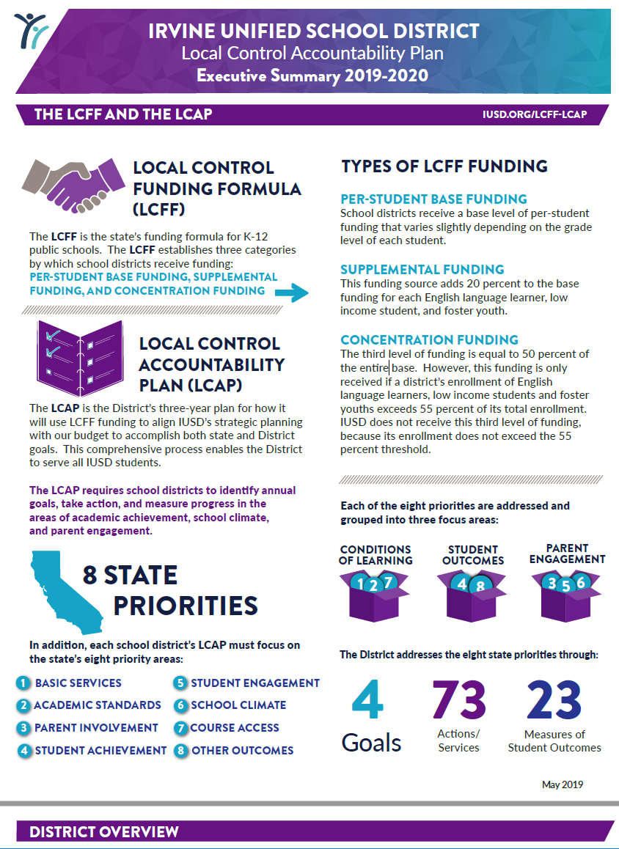
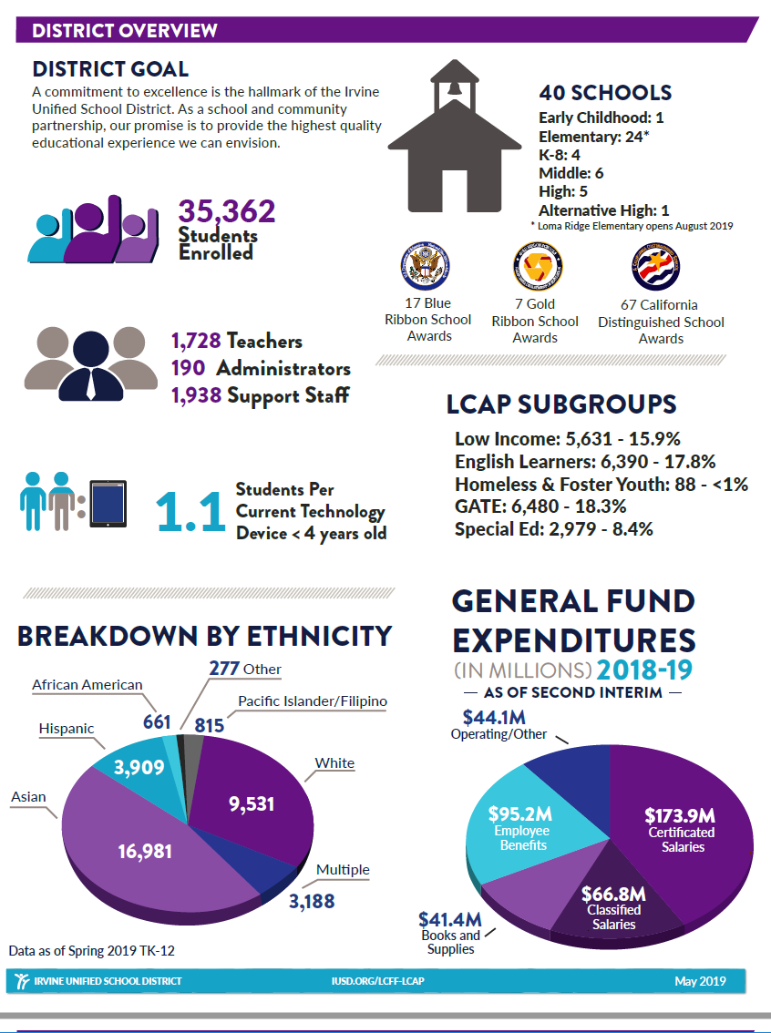
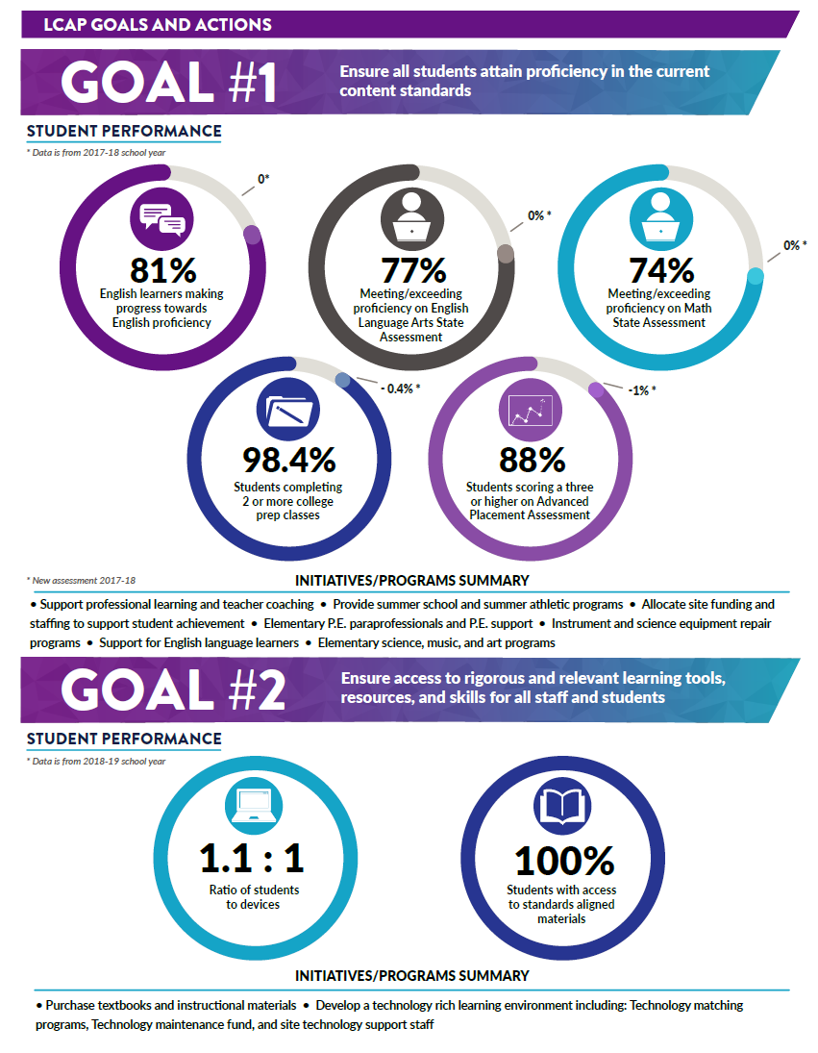
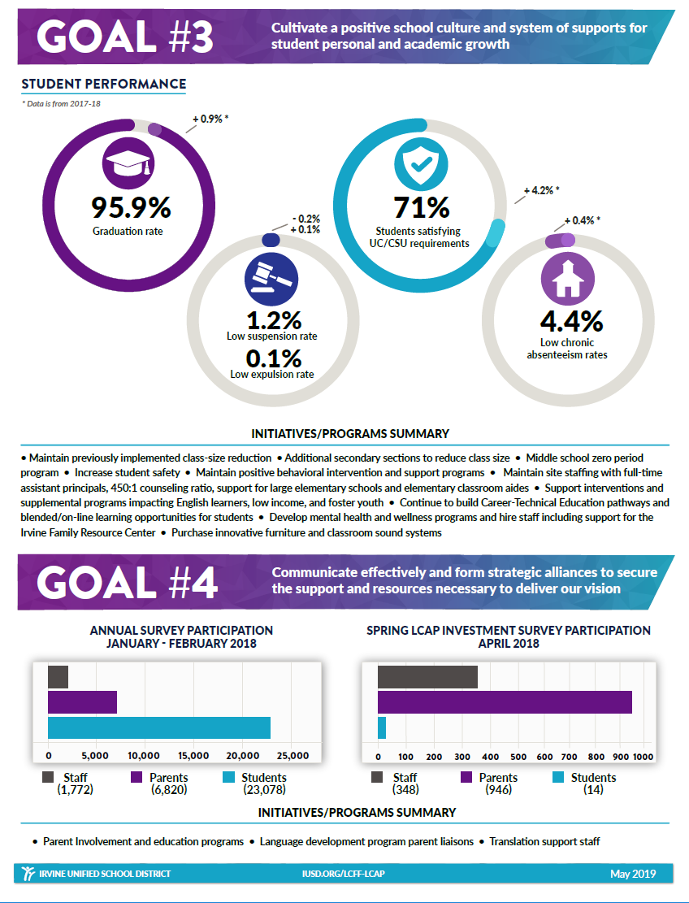
Executive Summary
3

Slide 4
Dashboard Indicators Fall 2018
Academic Performance |  | Status | Change
ELA Assessment |  | Very High | Maintained
Math Assessment |  | Very High | Maintained
College/Career |  | Very High | Increased
Local: Implementation of Academic Standards
Very Low
Very High
4

Slide 5
Dashboard Indicators Fall 2018
Academic Engagement |  | Status | Change
Chronic Absenteeism |  | Low | Increased
Graduation Rate |  | Very High | Maintained
Local: Access to a Broad Course of Study
Very Low
Very High
5

Slide 6
Dashboard Indicators Fall 2018
Conditions and Climate |  | Status | Change
Suspension Rate |  | Low | Declined
Local: Basics: Teachers, Instructional Materials, Facilities
Local: Parent Engagement
Local: Local Climate Survey
Very Low
Very High
6

Slide 7
Additional Dashboard Indicator
Academic Performance
English Learner Progress:
Well Developed: 55.8%
Moderately Developed: 24.3%
Somewhat Developed: 11.3%
Beginning Stage: 8.6%
7

Slide 8
IRVINE UNIFIED School district
Local Control
Accountability Plan
Part 2: Annual Update
8

Slide 9
Pupil Achievement
 | All Students: Math Assessment
 | English Learner |  | Asian
 | Socioeconomic Disadvantaged |  | Filipino
 | Foster Youth |  | Hispanic
 | Homeless Youth |  | Pacific Islander
 | Students With Disabilities |  | White
 | African American |  | Two or more races
74%
Met or Exceeded Standard
87% Progress towards English Proficiency
9
Very Low
Very High

Slide 10
Pupil Achievement
 | All Students: ELA Assessment
 | English Learner |  | Asian
 | Socioeconomic Disadvantaged |  | Filipino
 | Foster Youth |  | Hispanic
 | Homeless Youth |  | Pacific Islander
 | Students With Disabilities |  | White
 | African American |  | Two or more races
77%
Met or Exceeded Standard
87% Progress towards English Proficiency
10
Very Low
Very High

Slide 11
Broad Course of Study
 | All Students: College/Career Readiness
 | English Learner |  | Asian
 | Socioeconomic Disadvantaged |  | Filipino
 | Foster Youth |  | Hispanic
 | Homeless Youth |  | Pacific Islander
 | Students With Disabilities |  | White
 | African American |  | Two or more races
73.8%
Met Standard
87% Progress towards English Proficiency
11
Very Low
Very High

Slide 12
College/Career Readiness
98%
Completion of 2 or More College Prep Classes
88%
Scoring 3 or Higher on Advanced Placement Assessments
71.0%
Students Satisfying UC/CSU Requirements
87% Progress towards English Proficiency
12

Slide 13
Pupil Engagement
 | All Students: Graduation Rate
 | English Learner |  | Asian
 | Socioeconomic Disadvantaged |  | Filipino
 | Foster Youth |  | Hispanic
 | Homeless Youth |  | Pacific Islander
 | Students With Disabilities |  | White
 | African American |  | Two or more races
95.9%
87% Progress towards English Proficiency
13
Very Low
Very High

Slide 14
Pupil Engagement
 | All Students: Chronic Absenteeism
 | English Learner |  | Asian
 | Socioeconomic Disadvantaged |  | Filipino
 | Foster Youth |  | Hispanic
 | Homeless Youth |  | Pacific Islander
 | Students With Disabilities |  | White
 | African American |  | Two or more races
4.4%
87% Progress towards English Proficiency
14
Very Low
Very High

Slide 15
School Climate
 | All Students: Suspension Rate
 | English Learner |  | Asian
 | Socioeconomic Disadvantaged |  | Filipino
 | Foster Youth |  | Hispanic
 | Homeless Youth |  | Pacific Islander
 | Students With Disabilities |  | White
 | African American |  | Two or more races
1.2%
87% Progress towards English Proficiency
15
Very Low
Very High

Slide 16
Access
1.1 : 1
Student to Computer Ratio
100%
Student access to Standards Aligned Materials
87% Progress towards English Proficiency
16

Slide 17
IRVINE UNIFIED School district
Local Control
Accountability Plan
Part 3: Stakeholder Engagement
17

Slide 18
LCAP Overview
IUSD has completed an in-depth process to engage stakeholders:
Sharing information on LCFF and LCAP
Gathering input on developing the draft 2019-20 LCAP
Gathering feedback on draft 2019-20 LCAP
June 2019:
Final review and approval of 2019-20 LCAP
18

Slide 19
IRVINE UNIFIED School district
Local Control
Accountability Plan
Part 4: Goals, Actions, and Services
19

Slide 20
Determining LCAP Actions and Expenditures
2019-20 LCAP Focus:
$9,180,560 in actions scheduled to end in June of 2019
After review and careful consideration of stakeholder feedback, the Superintendent and Cabinet have designed the following plan:
Aligned with eight state priorities and four district goals
Created without using any of the new “2019-20” funding confirmed in the “May Revise”
20

Slide 21
Irvine LCAP Goals
1. Ensure all students attain proficiency in the current content standards.
2. Ensure access to rigorous and relevant learning tools, resources, and skills for all staff and students.
3. Cultivate a positive school culture and system of supports for student personal and academic growth.
4. Communicate effectively and form strategic alliances to secure the support and resources necessary to deliver our vision.
21

Slide 22
Investments: Student Instructional Support
Description | 2018-19 Allocation | 2019-20 Proposed | LCAP One-Time | LCAP Ongoing | Notes
Elementary PE Paraprofessionals | $660,000 | $360,000 ($660,000 per year) | $270,000 | $90,000 | $300,000 Non-LCAP
Elementary Art Grades 1-3 | $300,000 | $600,000 ($300,000 per year) | $600,000 |  | Over 2 years
Reduce Class Size at Secondary | $925,000 | $1,000,000 |  | $1,000,000
Support for Career Technical Education | $200,000 | $200,000 (May 2019) | $200,000 |  | LCAP Addition
Increased Secondary Allocation to Support Impacted and Intervention Classes | $820,000 | $1,000,000 | $1,000,000
Summer School Programs | $300,000 | $300,000 | $300,000
Subtotal: | $3,205,000 | $3,460,000 | $2,370,000 | $1,090,000
22

Slide 23
1327 Survey Responses: Student Instructional Support
Comprehensive Survey Results: 503 responses
Description | Highly Likely/Likely | Not Likely/Will not | No Opinion
Elementary PE Paraprofessionals | 81% | 12% | 7%
Elementary Art Grades 1-3 | 83% | 11% | 6%
Reduce Class Size at Secondary | 91% | 6% | 3%
Support for Career Technical Education (Survey Results from April 2018) | 56% | 29% | 15%
Increased Secondary Allocation to Support Impacted and Intervention Classes | 80% | 10% | 10%
Summer School Programs | 77% | 16% | 7%
Condensed Survey Results: 824 responses | 85% | 6% | 9%
23

Slide 24
Investments: Increase School Site Funding
Description | 2018-19 Allocation | 2019-20 Proposed | LCAP One-Time | LCAP Ongoing | Notes
VAPA Instrument Repair Specialist | $80,000 | $90,000 |  | $90,000
Science Equipment Repair Contract | $18,000 | $18,000 |  | $18,000
P.E. Support | $140,000 | $125,000 (May 2019) | $125,000 |  | LCAP Addition
Purchase and Update Tech Equip. | $500,000 | $300,000 ($500,000 total investment) | $300,000 |  | $200,000 (ongoing 18-19)
Site Technology Mentors | $250,000 | $250,000 | $250,000
Project Success | $240,000 | $240,000 | $240,000
Guidance Assistants | $335,000 | $335,000 | $335,000
Elementary Resource Specialists | $1,160,000 | $500,000 ($1,160,000 total investment) | $305,000 | $195,000 | $360,000 (non-LCAP) $300,000 (ongoing 18-19)
Expand Blended Learning Options | $500,000 | $400,000 ($700,000 total investment) | $300,000 | $100,000 | $300,000 (ongoing 18-19)
Subtotal: | $3,223,000 | $2,258,000 | $1,855,000 | $403,000
24

Slide 25
1327 Survey Responses: Increase School Site Funding
Comprehensive Survey Results: 503 responses
Description | Highly Likely/Likely | Not Likely/Will not | No Opinion
VAPA Instrument Repair Specialist | 71% | 18% | 11%
Science Equipment Repair Contract | 86% | 7% | 7%
P.E. Support | 74% | 19% | 7%
Purchase and Update Tech Equipment | 90% | 7% | 3%
Site Technology Mentors | 68% | 24% | 8%
Project Success | 77% | 17% | 6%
Guidance Assistants | 74% | 18% | 8%
Elementary Resource Specialists | 78% | 16% | 6%
Expand Blended Learning Options | 66% | 26% | 8%
Condensed Survey Results: 824 responses | 87% | 7% | 6%
25

Slide 26
Investments: CA Aligned Materials and Support
Description | 2018-19 Allocation | 2019-20 Proposed | LCAP One-Time | LCAP Ongoing | Notes
Curriculum TOSAs | $1,700,000 | $1,625,000 | $1,125,000 | $500,000
Ed. Tech TOSAs | $330,560 | $375,000 | $375,000
Stipends for Teacher Mentors | $150,000 | $300,000 ($150,000 per year) | $300,000 |  | Over 2 years
Part-Time Facilitator Teacher Coaches for PLCs | $1,568,000 | $875,000 ($1,245,000 total investment) | $562,000 | $313,000 | $370,000 (ongoing 18-19)
Curriculum Development: NGSS | $132,000 | $132,000 | $132,000
Special Ed IEP Software Support | $150,000 | $125,000 |  | $125,000
Student Online Assessment Technology |  | $355,000 | $110,000 | $245,000
Subtotal: | $4,030,560 | $3,787,000 | $2,604,000 | $1,183,000
26

Slide 27
1327 Survey Responses: CA Aligned Materials and Support
Comprehensive Survey Results: 503 responses
Description | Highly Likely/Likely | Not Likely/Will not | No Opinion
Curriculum TOSAs | 65% | 25% | 10%
Ed. Tech TOSAs | 67% | 24% | 9%
Stipends for Teacher Mentors | 72% | 21% | 7%
Part-Time Facilitator Teacher Coaches for PLCs | 60% | 28% | 12%
Curriculum Development: NGSS | 82% | 9% | 9%
Special Ed IEP Software Support | 74% | 16% | 10%
Student Online Assessment Technology | 75% | 16% | 9%
Condensed Survey Results: 824 responses | 80% | 13% | 7%
27

Slide 28
Investments: Equity, Safety and Support
Description | 2018-19 Allocation | 2019-20 Proposed | LCAP One-Time | LCAP Ongoing | Notes
Reduce Induction Fees | $100,000 | $300,000 ($150,000 per year) | $300,000 |  | Over 2 years
Technology Maintenance Fund | $400,000 | $800,000 ($1 M total) | $800,000 |  | $200,000 (ongoing 18-19)
Professional Learning Software |  | $245,000 | $110,000 | $135,000
Integrated Position Control System | $100,000 | $100,000 | $100,000
Counseling TOSA | $130,000 | $130,000 | $130,000
Stipends-Increased Theater Support | $20,000 | $20,000 |  | $20,000
Summer School Athletic Augmentation | $30,000 | $30,000 | $30,000
Innovative Furniture - NEW |  | $500,000 | $500,000
Classroom Sound System - NEW |  | $224,000 | $224,000
Subtotal: | $780,000 | $2,349,000 | $2,194,000 | $155,000
28

Slide 29
1327 Survey Responses: Equity, Safety and Support
Comprehensive Survey Results: 503 responses
Description | Highly Likely/Likely | Not Likely/Will not | No Opinion
Reduce Induction Fees | 74% | 19% | 7%
Technology Maintenance Fund | 89% | 7% | 4%
Professional Learning Software | 60% | 29% | 11%
Integrated Position Control System | 61% | 22% | 17%
Counseling TOSA | 67% | 23% | 10%
Stipends-Increased Theater Support | 68% | 20% | 12%
Summer School Athletic Augmentation | 59% | 27% | 14%
Innovative Furniture - NEW | 69% | 25% | 6%
Classroom Sound System - NEW | 63% | 29% | 8%
Condensed Survey Results: 824 responses | 85% | 6% | 9%
29

Slide 30
LCAP Federal Addendum
Adopted by the State Board of Education (SBE) on March 14, 2018
Within California, Local Educational Agencies (LEAs) that apply for Every Student Succeeds Act (ESSA) funds are required to complete the Local Control and Accountability Plan (LCAP), the LCAP Federal Addendum Template (Addendum), and the Consolidated Application (ConApp).
The LCAP Federal Addendum includes details on how IUSD allocates resources for Title I, Title II, Title III, and Title IV to meet the Local Educational Agency (LEA) Plan provisions of the ESSA.

Slide 31
Consolidated Application
To receive specific categorical funds for school year, the Board of Education must approve the Application For Funding
IUSD is eligible for the following categorical programs:
Title I: Improving Academic Achievement ($2,153,588)
Title II: Improving Teacher Quality ($437,159)
Title III: Ensure English Learners Attain Proficiency in English ($1,137,924)
Title IV: Student Support and Academic Enrichment ($153,133)

Slide 32
LCFF Budget Overview for Parents
Adopted by the State Board of Education (SBE) Executive Director on December 31, 2018;
The Budget Overview for Parents must be developed in conjunction with, and attached as a cover to, the LCAP for 2019-20.
The Budget Overview for Parents uses language that is understandable and accessible to parents and is information displayed using visuals and graphics.
32

Slide 33
IRVINE UNIFIED School district
2019-20 Budget
33

Slide 34
2019-20 Budget Development Process
On May 9, 2019, the Governor released the May Revision to his 2019-20 January State Budget Proposal
Due to timing and in the absence of a Final State Adopted Budget, Districts build Budgets based on the Governor’s May Revision
The District’s Budget is updated throughout the year
First Interim – December
Second Interim – March
Budget assumptions are developed with guidance from:
The Orange County Department of Education
School Services of California (SSC)
The California Association of School Business Officials (CASBO)
A variety of other sources….
34

Slide 35
From May Revision to Budget Enactment
Budget Conference
Committee Hearings
By June 15
By June 30
May Revision
Governor Releases
Revised Budget
Big Three
Negotiations
Governor Acts on
Budget
Budget Subcommittee
Hearings and
Recommendations
Legislature
Passes Budget
35

Slide 36
January Budget vs. May Revision
Item | January Budget | May Revision
LCFF Funding | $2.023 billion | $1.959 billion
Proposition 98 Minimum Guarantee 2017-18 2018-19 2019-20 | $75.5 billion $77.9 billion $80.7 billion | $75.6 billion $78.1 billion $81.1 billion
2019-20 COLA | 3.46% | 3.26%
One-Time Discretionary Funds for 2019-20 | $0 | $0
“Special Education” Proposal | $390 million ongoing $186 million one-time | $696.2 million ongoing
CalSTRS* Proposal | $3 billion one-time (non-Proposition 98) | $3.15 billion one-time (non-Proposition 98)
36

Slide 37
Proposition 98 Funding
Proposition 98 funding levels have increased from the 2019-20 Governor’s January Budget proposal for all three fiscal years
Largely due to increases in General Fund revenues and slower-than-expected average daily attendance (ADA) decline
2017-18
$75.5 billion
2017-18
$75.6 billion
Governor’s Budget
May Revision
Proposition 98 Minimum Guarantee
2018-19
$77.9 billion
2018-19
$78.1 billion
2019-20
$80.7 billion
2019-20
$81.1 billion
37

Slide 38
Risks to the State Budget
While the economy continues to grow many economists are projecting a slowdown in the near future
UCLA identifies five key risks to California’s economy:
Volatile stock market
Housing crisis
An aging population
Federal trade policy and conflicts with China and Mexico
Overall policy conflicts with the federal government
Other areas of concern:
Length of current expansion
Historically low unemployment
Economic Slowdown
Global Economy
Trade
38

Slide 39
2019-20 May Revise Highlights
With full funding of the LCFF in 2018-19, the Governor’s proposal includes funding of the projected statutory Cost-of-Living Adjustment (COLA) only……
Governor’s Funding priorities outside of LCFF:
CalSTRS Pension Payment - $3.15 billion allocated to reduce pension liability and district contribution
Special Education - $696 million to support additional services for districts with high concentrations of disadvantaged student populations
Early Childhood Education- Over $1.0 billion allocated to support Universal Preschool, Full Day Kindergarten and Child Care programs
Proposition 51 Funding - $1.5 billion in facility bonds to be sold
No one-time discretionary funds…..
39

Slide 40
2019-20 May Revise Highlights
LCFF Ongoing Funding:
Governor’s proposal funds a Cost-of-Living Adjustment (COLA) projected at 3.26%
In contrast to last year’s “Super COLA”, no additional funding proposed for LCFF
Impact of COLA for IUSD is approximately $10.1 million
Overall increase in LCFF funding including growth is projected at $15.4 million
40

Slide 41
Progress Toward LCFF Implementation

Slide 42
Enrollment Growth
556
674
1236
1062
927
1269
1051
887
927
42

Slide 43
Breakdown of Available Funding
Growth $5.3M
LCFF Increase
$15.4M
COLA
$10.1M
43

Slide 44
CalSTRS Proposal
The Governor’s May Revision provides an additional $150 million to his January proposal that would further reduce the employer share of the CalSTRS unfunded liability
Reduce 2019-20 rates from 18.13% to 16.7% and 2020-21 rate from 19.1% to 18.1%
Reduce the employers’ share of the unfunded liability and reduce employer contribution rates long term by an estimated 0.5%
$3.15 billion one-time non-Proposition 98 to reduce liabilities for employers
$850 million
$2.3 billion
44

Slide 45
CalSTRS Employer Contribution Rates – Current Law Versus May Revise

Slide 46
STRS & PERS Projected Increases
$52.2M
$12.4M

Slide 47
Utilization of Ongoing $15.4 M Funding ($ in millions)
47

Slide 48
Building 2019-20 LCAP/Budget
Due to significant influx of “one-time” funds, prior years’ LCAPs were designed to allocate funds over multiple years
Recognizing that the District planned approximately $9.2 million in “one-time” investments that were targeted to drop off at the end of 2019, all current year resources, both one-time and ongoing, were set aside to ensure that critical investments could be maintained
2018-19 Available:
$13 million on-going
$11 million one-time
The 2019-20 State Budget will not be finalized until June
48

Slide 49
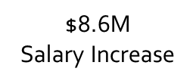
2019-20 LCAP Funding
2018-19
Based on 2018-19 budget and First Interim Report, the District identified approximately $24 million in available funds in 2018-19.
Ongoing
$13 M
One-time
$11 M
$.8 M
H&W Contribution
2019-20
$.7 M
Innovative Furniture & Growth
Ongoing
$6.9 M
One-time
$3.9 M
$1.4 M Growth
$9 M
LCAP
$6.9 M
Available
$.2 M Sub Rate Increase
$2.8 M
LCAP
$3.9 M Available
$0.5 M
Available

Slide 50
2018-19 thru 2021-22 Budget Forecast Unrestricted General Fund
Description | 2018-19 Estimated | 2019-20 Projected | 2020-21 Projected | 2021-22 Projected
Total Revenues | $329,881,633 | $339,145,736 | $355,375,841 | $370,884,595
Total Expenditures | ($266,496,044) | ($279,666,906) | ($279,664,977) | ($287,969,107)
EXCESS (DEFICIENCY) | $63,385,589 | $59,478,830 | $75,710,864 | $82,915,488
Other Sources/Uses | ($63,279,974) | ($70,054,591) | ($62,216,652) | ($64,250,696)
Net Increase/(Decrease) | $105,615 | ($10,575,761) | $13,494,212 | $18,664,792
Beginning Balance | $44,009,892 | $44,115,507 | $33,539,746 | $47,033,958
Projected Ending Balance | $44,115,507 | $33,539,746 | $47,033,958 | $65,698,750
50

Slide 51
2018-19 thru 2021-22 Budget Forecast Unrestricted General Fund
Description | 2018-19 Estimated | 2019-20 Projected | 2020-21 Projected | 2021-22 Projected
Estimated Ending Fund Balance | $44,115,507 | $33,539,746 | $47,033,958 | $65,698,750
Components of Fund Balance:
Revolving Cash/Stores | $550,000 | $550,000 | $550,000 | $550,000
State Recommended DEU | $7,952,000 | $8,464,000 | $8,060,926 | $8,282,281
Contingency Reserve | $5,000,000 | $5,000,000 | $5,000,000 | $5,000,000
Textbook Reserve | $4,730,580
Site Department Carryover | $7,800,000
Reserved for 2019-20 LCAP | $12,919,979 | $600,000
Unallocated 2019-20 LCAP |  | $3,907,000 | $3,907,000 | $3,907,000
2019-20 May Revise Unallocated |  | $6,900,000 | $6,900,000 | $6,900,000
Projected 2018-19 Available |  | $5,162,948 | $5,162,948 | $5,162,948
Other Assigned | $5,162,948 | $2,955,798 | $17,453,084 | $35,896,521
51

Slide 52
2019-20 Budget & Multiyear Projections Unrestricted General Fund
Illustration With Unallocated Allocations
Description | 2018-19 Estimated | 2019-20 Projected | 2020-21 Projected | 2021-22 Projected
Total Revenues | $329,881,633 | $339,145,736 | $355,375,841 | $370,884,595
Total Expenditures | ($266,496,044) | ($279,666,906) | ($279,664,977) | ($287,969,107)
Currently Unallocated Ongoing |  | $6,900,000 | $6,900,000 | $6,900,000
Currently Unallocated One-Time |  | $9,069,948
Revised Total Expenditures | ($266,496,044) | ($295,636,854) | ($286,564,977) | ($294,869,107)
EXCESS (DEFFICIENCY) | $63,385,589 | $43,508,882 | $68,810,864 | $76,015,488
Total Other Sources/Uses | ($63,279,974) | ($70,054,591) | ($62,216,652) | ($64,250,696)
NET INCREASE (DECREASE) | $105,615 | ($26,545,709) | $6,594,212 | $11,764,792
Beginning Balance | $44,009,892 | $44,115,507 | $17,569,798 | $24,164,010
Ending Balance | $44,115,507 | $17,569,798 | $24,164,010 | $35,928,802
52

Slide 53
IRVINE UNIFIED School district
Questions?

