Slide 1
Irvine Unified School District
LCAP/Budget Update for
Public Hearing
June 13, 2017

Slide 2
Local Control Accountability Plan Part 1: Plan Summary
2

Slide 3
Dashboard Indicators
Status
Change
Suspension:
Low
Maintained
EL Progress:
Very High
Increased
Graduation:
Very High
Maintained
ELA/Math:
Very High
Maintained
3

Slide 4
Local Control Accountability Plan Part 2: Annual Update
4

Slide 5
Academic
75%
Met or Exceeded Standard
Math Assessment
79%
Met or Exceeded Standard
ELA Assessment
87.4%
English Learner Progress
87% Progress towards English Proficiency
5

Slide 6
Climate
1.4%
Suspension Rate
0.0%
Expulsion Rate
4.2%
Chronic Absenteeism
Rate
96.3%
Graduation Rate
87% Progress towards English Proficiency
6

Slide 7
Access
2:1
Student to Computer Ratio
100%
Student access to Standards Aligned Materials
87% Progress towards English Proficiency
7

Slide 8
College/Career Readiness
98%
Completion of 2 or More College Prep Classes
89%
Scoring 3 or Higher on Advanced Placement Assessments
69.4%
Students Satisfying UC/CSU Requirements
87% Progress towards English Proficiency
8

Slide 9
Local Control Accountability Plan Part 3: Stakeholder Engagement
9

Slide 10
LCAP Overview
IUSD has completing an in-depth process to engage stakeholders:
Sharing information on LCFF and LCAP
Gathering input on developing the draft 2017-18 LCAP
Gathering feedback on draft 2017-18 LCAP
June 2017:
Final review and approving 2017-18 LCAP
10

Slide 11
Local Control Accountability Plan Part 4: Goals, Actions and Services
11

Slide 12
Determining LCAP Actions and Expenditures
As a result of the feedback received, the Superintendent and Cabinet have designed additional investments to support the eight state priorities and the four District goals. These actions are additional expenditures which will be added to the current three year LCAP reflecting increased funding. Expenditures include an approximate increase of $8.5 million in one-time funds.
Irvine Unified School District Local Control Accountability Plan (LCAP) Goals:
1. Ensure all students attain proficiency in the current content standards.
2. Ensure access to rigorous and relevant learning tools, resources, and skills for all staff and students.
3. Cultivate a positive school culture and system of supports for student personal and academic growth.
4. Communicate effectively and form strategic alliances to secure the support and resources necessary to deliver our vision.
12

Slide 13
Additional Investments
Proposed Action | Ongoing | One-Time
 |  | 17-18 | 18-19
Summer Athletic Camp Augmentation |  | $30,000 | $30,000
Science Equipment Repair Contract |  | $18,000
Assistive Technology Devices |  | $130,000
Technology Maintenance Fund |  | $400,000
Student Online Assessment Tool |  | $400,000
Professional Learning Software |  | $110,000
Classroom Technology Grants |  | $515,280
Irvine Family Resource Center Support |  | $125,000
13

Slide 14
Survey Responses
Proposed Action | Highly Likely/Likely | Not Likely/ Will not | No Opinion
Summer Athletic Camp Augmentation | 57.8% | 30.7% | 11.6%
Science Equipment Repair Contract | 94.5% | 3.4% | 2.1%
Assistive Technology Devices | 76.7% | 14.9% | 8.4%
Technology Maintenance Fund | 94.0% | 4.8% | 1.3%
Student Online Assessment Tool | 73.2% | 19.6% | 7.1%
Professional Learning Software | 78.0% | 16.3% | 5.8%
Classroom Technology Grants | 90.3% | 7.6% | 2.1%
Irvine Family Resource Center Support | 78.1% | 13.9% | 8.0%
14

Slide 15
Continued Funding for Existing Actions
Proposed Action | 2017-18 | 2018-19
K-12 Summer School Programs | $300,000 | $300,000
Curriculum Teachers on Special Assignment |  | $1,700,000
Primary Art Instruction | $300,000
Instrument Repair Supplies | $15,000
Technology Matching Program (Additional funds 17/18) | $200,000
Education Technology Teachers on Special Assignment |  | $330,560
Technology Mentors (Addition of Portola HS) | $22,037
Textbook Funding (Increase 17/18, add funds 18/19) | $2,000,000 | $1,000,000
Augmentation to Elementary Resource Counselor Program | $482,000
Online Learning | $150,000
15

Slide 16
2017-18 Budget
16

Slide 17
2017-18 May Revise Highlights
While the 2017-18 May Revise provides additional funding to support K-12 education, the Administration continues to caution against an impending recession
Current economic expansion began in 2009 – only two years shorter than the longest recovery since World War II
2016-17 State revenues continue to fall short of budgeted projections
Citing the continued growth and strength of the stock market, and in contrast to the current projected shortfall in state revenues, the Governor’s May Revise forecasts an increase of $1.9 billion in state revenues in 2017-18
Increased 2017-18 revenue projections provide additional $1.1 billion in Proposition 98 funding from what was proposed in January
Recognizing 2017-18 revenue projections may be overly optimistic, Governor’s May Revise Proposal contains contingency language for Proposition 98
17

Slide 18
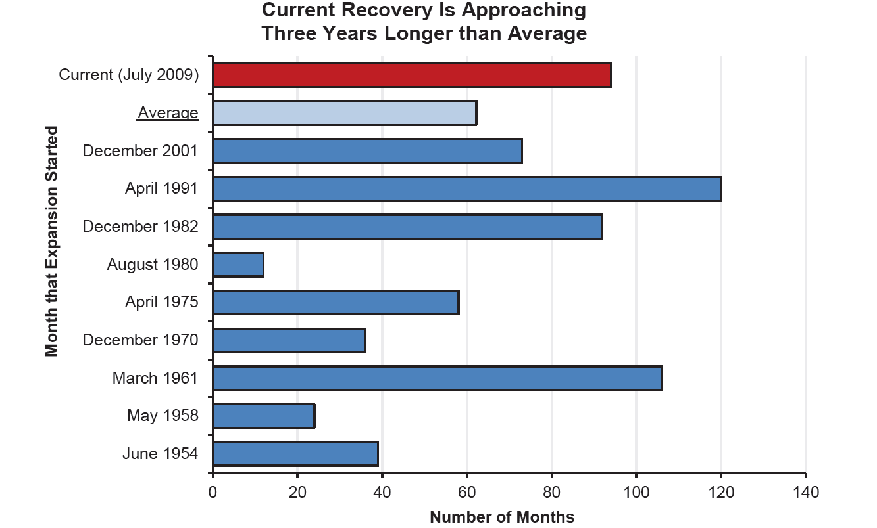
Economic Recovery
18

Slide 19
General Fund Revenues in 2017-18 – Big Three
19

Slide 20
Big Three Taxes – Percent Change
Source: 2016-17 May Revision, pg. 87
20

Slide 21
2017-18 May Revise Highlights
Governor’s proposal includes approximately $1.4 billion to fund a 1.56% Cost-of-Living Adjustment and additional funding for the continued implementation of the Local Control Funding Formula (LCFF)
Increased funding is estimated to eliminate 43.97% of the remaining gap in LCFF funding statewide and bring total formula implementation to 97%
2017-18 LCFF funding provides an average increase in per-pupil funding of $249 per Average Daily Attendance (ADA)
For IUSD, due to the structure of the LCFF calculation and IUSD’s relatively low unduplicated disadvantaged population, the estimated increase is $217 per ADA
21

Slide 22
Progress Toward LCFF Implementation
22

Slide 23
2017-18 May Revise Highlights
Discretionary Block Grant -
Based on the more optimistic revenue projections for 2017-18, the May Revise includes an increase of $750 million for a one-time discretionary block grant
The additional funding increases the per ADA allocation included in the January proposal from $48 to $173
For IUSD this represents approximately $5.7 million or an increase of approximately $4.2 million from the January proposal
The Discretionary Block Grant comes with a catch however……
Funds will be released in May 2019 and only if revenues come in as projected to support the forecast Proposition 98 Guarantee
Funds will not be included in District budget until contingencies have been removed
23

Slide 24
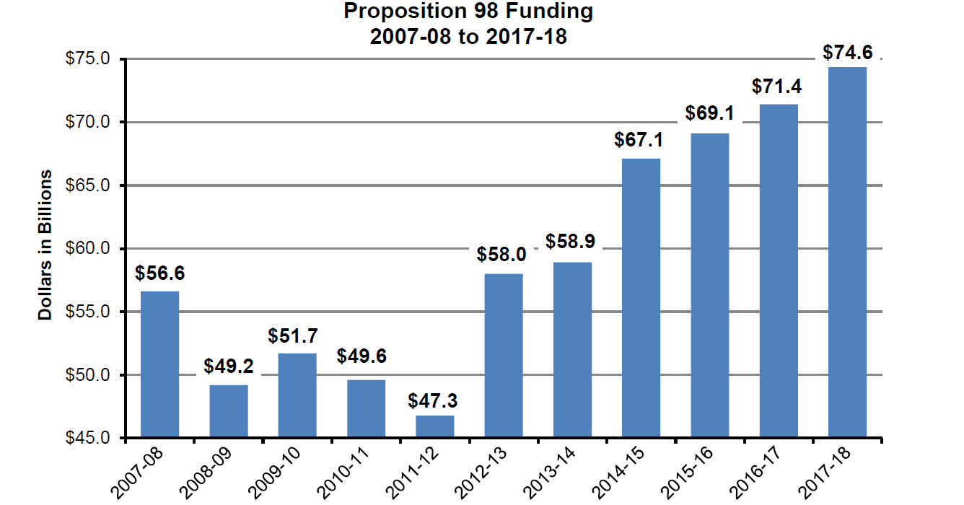
K-12 & Community College Funding
24

Slide 25
IUSD Estimated LCFF Funding
IUSD LCFF | 2016-17 Estimated | 2017-18 Projection | 2018-19 Projection | 2019-20 Projection
LCFF Target (Actual Target to be Reached in 2020-21) | $273,267,973 | $285,475,214 | $300,218,377 | $318,250,829
LCFF Floor (2012-13 Actual Funding Adjusted for ADA Growth & any LCFF Funding Received) | $246,209,803 | $268,162,003 | $283,458,075 | $300,257,165
LCFF Gap = (Difference Between Target & Floor) | $27,058,170 | $17,313,211 | $16,760,302 | $17,993,664
Gap Funding Rate*= (% of Gap to be Funded) | 55.03% | 43.97% | 39.03% | 41.51%
Gap Funding Amount = (Anticipated Additional Funds) | $14,890,111 | $7,612,619 | $6,541,546 | $7,469,170
Total LCFF Funding = | $261,099,914 | $275,774,622 | $289,999,621 | $307,726,335
LCFF Increase - $15M
25
* Gap Funding Rates based on SSC projections

Slide 26
Department of Finance (DOF) vs. School Services of California (SSC) Projected LCFF “Gap” Funding Rates
26

Slide 27
Utilization of Ongoing Funding
27

Slide 28
Promise to Restore Purchasing Power
With the implementation of the LCFF in 2013-14, the stated goal was to fully fund the formula by 2020-21 and restore funding to pre-recession 2007-08 purchasing power levels
However, significant costs have been added which will make it very difficult to fully restore purchasing power to pre-recession levels
In 2014-15 CalSTRS employee and employer rate increases were approved, increasing the employer rate incrementally from 8.25% to 19.10% by 2020-21
CalPERS employer rates have increased from 11.44% in 2013-14 to an estimated 23.8% in 2020-21
For IUSD this represents an increase in costs of approximately $851/ADA or $28.5 million
Increased costs for Special Education and other nondiscretionary spending
28

Slide 29
STRS & PERS Projected Increases
29

Slide 30
Does the LCFF Restore Purchasing Power Lost?
%

Slide 31
2016-17 thru 2019-20 Budget Forecast Unrestricted General Fund
Description | 2016-17 Estimated | 2017-18 Projected | 2018-19 Projected | 2019-20 Projected
Total Revenues | $285,637,836 | $290,829,088 | $305,332,867 | $323,348,498
Total Expenditures | ($246,196,515) | ($247,065,909) | ($252,663,221) | ($265,306,638)
EXCESS (DEFICIENCY) | $39,441,321 | $43,763,179 | $52,669,646 | $58,041,860
Other Sources/Uses | ($48,545,459) | ($54,152,486) | ($52,420,539) | ($54,183,342
Net Increase/(Decrease) | ($9,104,138) | ($10,389,307) | $249,107 | $3,858,518
Beginning Balance | $49,258,496 | $40,154,358 | $29,765,051 | $30,014,158
Projected Ending Balance | $40,154,358 | $29,765,051 | $30,014,158 | $33,872,676
31

Slide 32
2016-17 thru 2019-20 Budget Forecast Unrestricted General Fund
Description | 2016-17 Estimated | 2017-18 Projected | 2018-19 Projected | 2019-20 Projected
Estimated Ending Fund Balance | $40,154,358 | $29,765,051 | $30,014,158 | $33,872,676
Components of Ending Fund Balance:
Revolving Cash/Stores | $550,000 | $550,000 | $550,000 | $550,000
State Recommended Minimum DEU | $7,136,000 | $7,010,000 | $7,054,933 | $7,324,776
Contingency Reserve | $5,000,000 | $5,000,000 | $5,000,000 | $5,000,000
Deferred 15-16 LCAP | $3,760,704
Deferred 16-17 LCAP | $5,943,601
Deferred 17-18 LCAP | $8,557,877 | $3,360,560
Site/Dept. Carryover | $7,569,128 | $7,569,128 | $7,569,128 | $7,569,128
Other Assigned | $1,637,048 | $6,275,363 | $9,840,097 | $13,428,772
32

Slide 33
2017-18 Budget & Multiyear Projections Unrestricted General Fund Illustration With Unallocated Allocations
Description | 2016-17 Estimated | 2017-18 Projected | 2018-19 Projected | 2019-20 Projected
Total Revenues | $285,637,836 | $290,829,088 | $305,332,867 | $323,348,498
Total Expenditures | ($246,196,515) | ($247,065,909) | ($252,663,221) | ($265,306,638)
Currently Unallocated Ongoing | ----------------- | ($3,300,000) | ($3,300,000) | ($3,300,000)
Currently Unallocated One-Time | ----------------- | ($7,569,128)
Revised Total Expenditures | ($246,196,515) | ($257,935,037) | ($255,963,221) | ($268,606,638)
EXCESS (DEFFICIENCY) | $39,441,321 | $32,894,051 | $49,369,646 | $54,741,860
Total Other Sources/Uses | ($48,545,459) | ($54,152,486) | ($52,420,539) | ($54,183,342
NET INCREASE (DECREASE) | ($9,104,138) | ($21,258,435) | ($3,050,893) | $558,518
Beginning Balance | $49,258,496 | $40,154,358 | $18,895,923 | $15,845,030
Ending Balance | $40,154,358 | $18,895,923 | $15,845,030 | $16,403,548
33

Slide 34
Questions
34

